Slide 1

Real Estate Industry Project
Applied Data Science (MAST30034) – Group 60
TO START
Slide Template: https://www.1ppt.com/article/72780.html#xiazai

Slide 2
Group Members
Kevin
Steven
Len
Aaron
Cecily

Slide 3

Background Information
Predicting Rental Prices
This industry project aims predict rental prices for both residential properties and apartments throughout Victoria.
The overall goal is recommend which region are most likely to increase in rental prices.

Slide 4
Steps
Prediction for population and income.
Stepwise selection
Feature Prediction
Feature Selection
1
3
5
2
4
Modelling
Data Scraping
Data Preprocessing
Find relative dataset
Historical Data
Scraping
API find distance
Geo Analysis
Linear regression
Random forest
Error analysis
Notes:
0bbc4188-a710-4151-b2e9-10d0a42a3567

Slide 5
Questions
What are the most important internal and external features in predicting rental prices?
What are the top 10 suburbs with the highest predicted growth rate?
What are the most livable and affordable suburbs according to your chosen metrics?

Slide 6

1
Important Internal and External Features
Features?

Slide 7

Internal Features
Important Features
Internal Features
Longitude, Latitude
Rental price per week，
Property type (apartments, etc..)
Room number
Postcode & SA2 Region

Slide 8

External Features
Important Features
External Features
SA2 Region
Total population.
Income
Distance to school & train station
Public transport
Interest rate

Slide 9
Data Preprocessing
Unified Data Format
API Find Distance
Remove Outliers
Price per week
Linear Distance & Real Distance
Notes:
3a17ac24-0fbc-426a-a5d3-69b8439c47b0

Slide 10
Feature Prediction
Assume income and population increasing linearly
INCOME
POPULATION
Based on data from
& Official Prediction for Year
Based on data from 2010-2015
Notes:
1fa1ba72-1f8c-41ef-ab3b-fa7a573af2f8

Slide 11
2
Top 10 suburbs with the highest predicted growth rate
Chosen Suburbs

Slide 12
API Find Distance
标题文本预设
此部分内容作为文字排版占位显示 （建议使用主题字体）
Route Distance
use the Directions API for server-side requests
Straight Line Distance
Calculate the straight line distance from latitude and longitude
Google API
此部分内容作为文字排版占位显示 （建议使用主题字体）
Notes:
0e291731-89f1-41aa-9628-932b817332ab

Slide 13
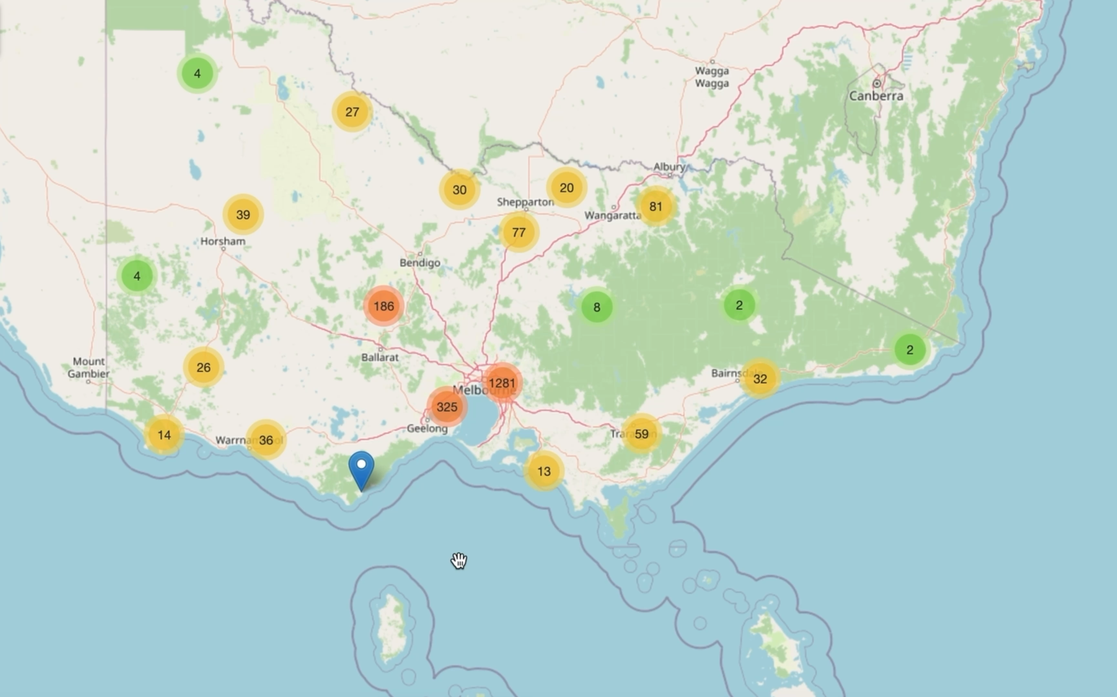
Geo Analysis
Notes:
0e291731-89f1-41aa-9628-932b817332ab

Slide 14
Feature Selection
标题文本预设
标题文本预设
标题文本预设
标题文本预设
此部分内容作为文字排版占位显示 （建议使用主题字体）。
此部分内容作为文字排版占位显示 （建议使用主题字体）。
此部分内容作为文字排版占位显示 （建议使用主题字体）。
此部分内容作为文字排版占位显示 （建议使用主题字体）。
Notes:
1e6a3e9d-93bf-4751-86a8-84b47664da3d

Slide 15
Modelling
Linear Regression
Random
Forest
20%
请编辑您的文本
请编辑您的文本请编辑您的文本请编辑您的文本请编辑您的文本请编辑您的文本请编辑您的文本
请编辑您的文本请编辑您的文本请编辑您的文本请编辑您的文本请编辑您的文本请编辑您的文本
请编辑您的文本请编辑您的文本请编辑您的文本请编辑您的文本请编辑您的文本请编辑您的文本

Slide 16
3
Most livable and affordable suburbs
Livable & Affordable

Slide 17

Livability
Affordability
01
02

Slide 18
Livability
Suburb
1
1: Education
2: Health Care
此部分内容作为文字排版占位显示
（建议使用主题字体）
2
此部分内容作为文字排版占位显示
（建议使用主题字体）
3. Infrastructure
4. Safety
此部分内容作为文字排版占位显示
（建议使用主题字体）
此部分内容作为文字排版占位显示
（建议使用主题字体）
3
4
Suburb
Notes:
1a291f84-6c3c-4f5b-88b5-64488956ca3f

Slide 19
Affordability
Population Growth
标题文本预设
Does people have the desire to live in this region?
此部分内容作为文字排版占位显示 （建议使用主题字体）
Pay Ability
标题文本预设
Whether people will be able to pay their rent
此部分内容作为文字排版占位显示 （建议使用主题字体）
Notes:
2a3ac505-70a0-48b3-9765-d105e67f600a

Slide 20
THANKS

